Slide 1

CAR PRICE PREDICTION
GROUP - 12

Slide 2
GROUP MEMBERS
V.V.S.N.SAI MOHAN -
AM.EN.U4CSE20275 AM.EN.U4CSE20248
M.VISHAL REDDY -
B.JAGADANANDA
S.MANIKANTA
K.NAVEEN KUMAR
AM.EN.U4CSE20217
AM.EN.U4CSE20268
- AM.EN.U4CSE20238

Slide 3

INTRODUCTION
Predicting the price of a used cars has been studied extensively in various researches.
Car price prediction is a somehow an interesting and popular problem.
As per information from the Agency for Statistics of BiH, the percentage of personal car usage is increased by 2.7% since 2013 and it is likely that this trend will continue, and the number of cars will increase day by day.
Accurate car price prediction involves expert knowledge, because price usually depends on many distinctive features and factors.
Typically, the most signiﬁcant ones are present price , brand and model, age, mileage etc. The fuel type used in the car as well as fuel consumption per mile highly affect the price of a car due to a frequent changes in the price of a fuel. Different features like exterior color, type of transmission, safety, air condition, etc. will also inﬂuence the car price.

Slide 4

PROBLEM STATEMENT
A model to predict the price of a used car should be developed in order to assess its value based on a variety of characteristics. Several factors affect the price of a used car, such as company, model, year, transmission, distance driven, fuel type, seller type, and owner type.
As a result, it is crucial to know the car's actual market value before purchasing or selling it.

Slide 5

CHALLENGES
Finding the best regression algorithm, among Linear Regression, Random Forest Regression, GBT regression, etc., for our problem was a challenge.
We had to learn about random forest,GBT regression since we weren't familiar with it.
Reconstructing the given dataset. Changing the categorical values into numerical form. And removing the unnecessary features.
The choice between randomizedsearchCV and gridsearchCV for ﬁnding hyperparameters of random forest regression presented a challenge.
We had a challenge in choosing dominant features for which we used heat maps using pearson coefﬁcient correlation and extra tree regressor and found the feature importance.

Slide 6

SOLUTION APPROACH
Step 1: "Car_Data.csv" dataset was taken from kaggle.com and was reconﬁgured to reﬂect the important features.
Data frames in which we loaded the dataset now include the Selling price , Present price, Kms driven, owner, age, Fuel Type, Seller type, Transmission type.
Step 2: Categorical features were then converted to numerical values.
We remove multiple columns of the dataset using the get_dummies function as some columns contain the same information because the original column could assume a binary value, The "CNG" fuel type, the "Automatic" transmission type, and the "Dealer" seller type were removed.
Step 3: We created a heat map using Pearson correlation to illustrate how the features are related.

Slide 7

SOLUTION APPROACH
Step 4: Using ExtraTreesRegressor the feature importances were obtained. And Present_Price turned out to be the feature with most importance.
We used Random Forest Regression to solve the problem and created a model based on this.
Step 5: By using randomizedsearchCV, we performed hyper parameter tuning
(n_estimators, max_features, max_depth, min_samples_split, min_samples_leaves).
Due to its speed, RandomizedSearchCV is better than GridSearchCV.
Step 6: The data has been split into training data (80%) and test data (20%).

Slide 8

SOLUTION APPROACH
Step 7: After getting the best parameters from the RandomizedSearchCV we train the model using the Random Forest Regression .
In the random forest regressor, the decision tree will scale the input, so we do not have to scale the values.
The graph of predictions is plotted using displot/ distplot in which we observe that it resembles a normal distribution with mean 0.
Step 8 : Predicting the price of manually entered data.

Slide 9

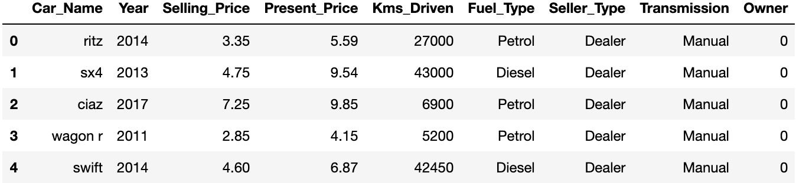
DATA SET-1
The data we have used in this project was downloaded from Kaggle. It was uploaded from Cardekho.com . The dataset consists of 301 rows and 9 columns with no null values. Column data consist of independent Features. The independent features contain both categorical and numeric values.

Slide 10

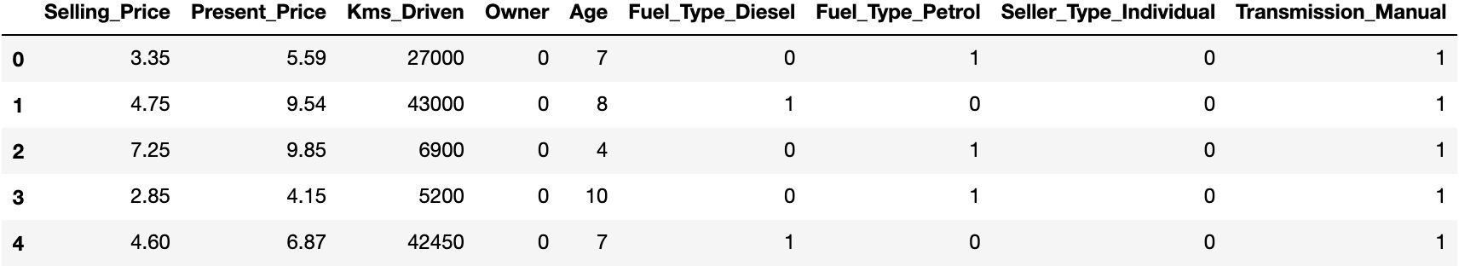
DATA SET MANIPULATION
From the original dataset we searched for null values using “isnull()”.
Removed the “car_name” column from the dataset. We added a new feature “Age” by subtracting current year and purchase year. Then we dropped the “Year” column.
As the dataset has numerical values and categorical values , We remove multiple columns of the dataset using the get_dummies function as some columns contain the same information because the original column could assume a binary value,
The "CNG" fuel type, the "Automatic" transmission type, and the "Dealer" seller type were removed from the unique values.

Slide 11
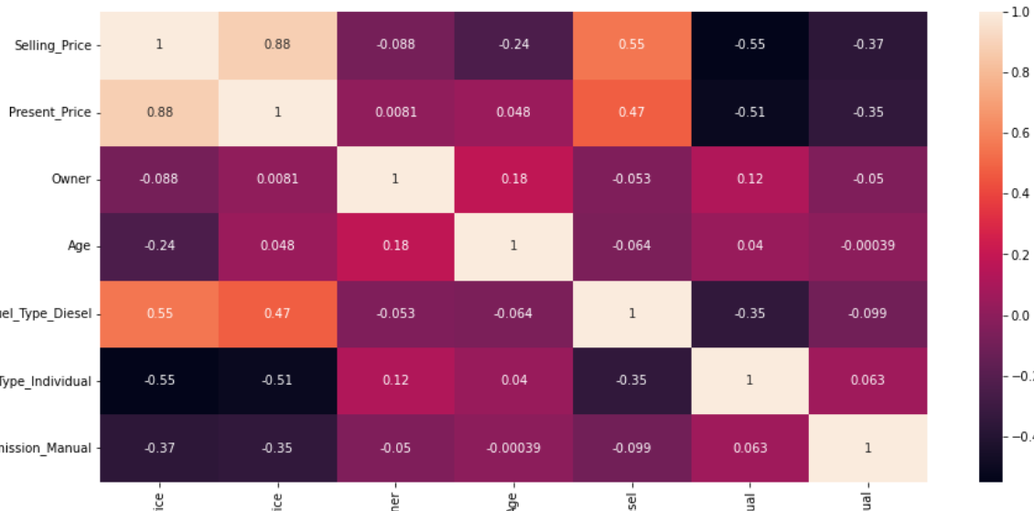
FINAL DATASET
Using the Extra Trees Regressor the feature importances are found.
The Present Price is the feature with most importance
And also we computed the correlation of all the features , we used “pearson” method.
And from that the we found that Selling price and the present price are much correlated.
And a heatmap is used to plot the correlation between 2 features.

Slide 12

GITHUB REPO
Link:
https://github.com/VennamVenkataSivaNagaSaiMohan/Car_price_prediction

Slide 13
MODELS
As the problem data set is based on regression we took
1. Linear Regression
2. Random Forest Regression
3. GBT
These algorithms we used in our dataset.

Slide 14
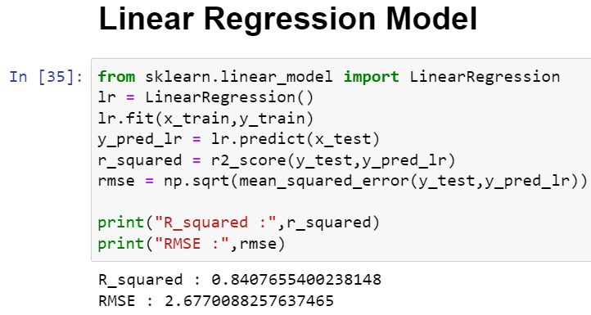
Linear Regression
For this model:
Accuracy = 84%
Error = 2.07

Slide 15
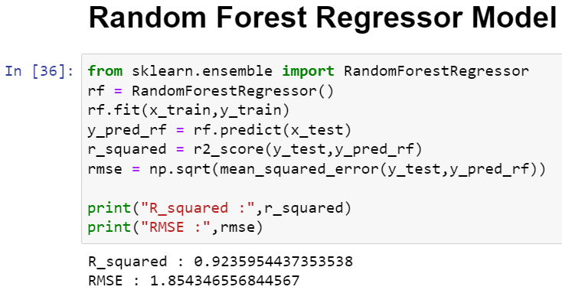
Random Forest Regression
For this model:
Accuracy = 92%
Error = 1.85

Slide 16
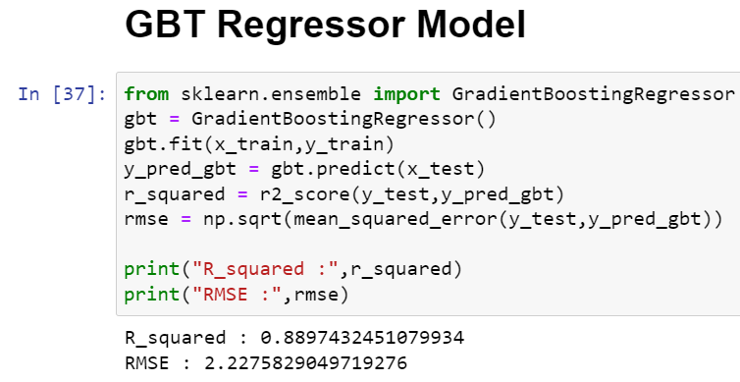
Gradient Boosting Regressor
For this model:
Accuracy = 88%
Error = 2.22

Slide 17
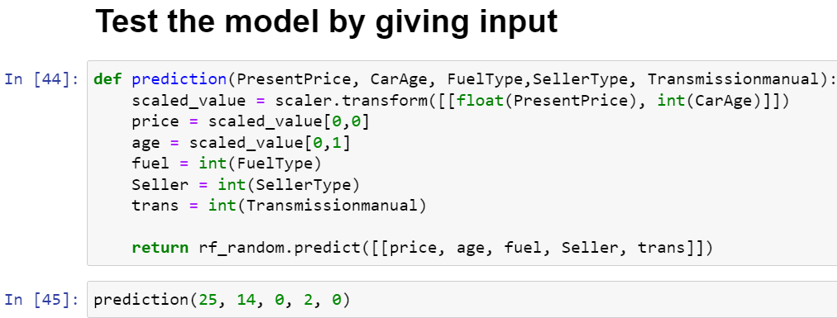
Testing the model
Predicting the price using the manual input. So we can easily calculate price of car using these models.

Slide 18
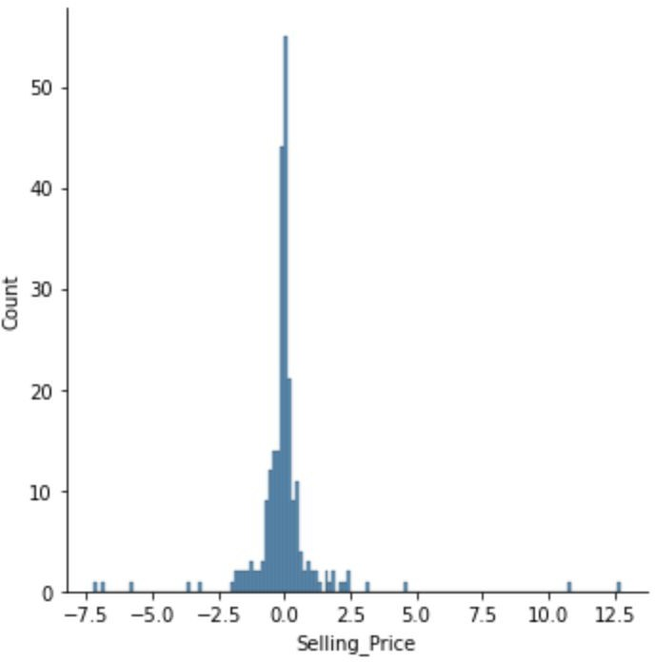
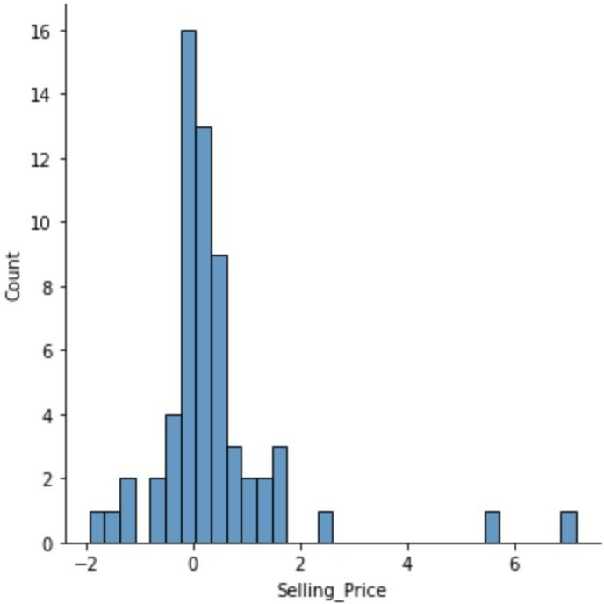
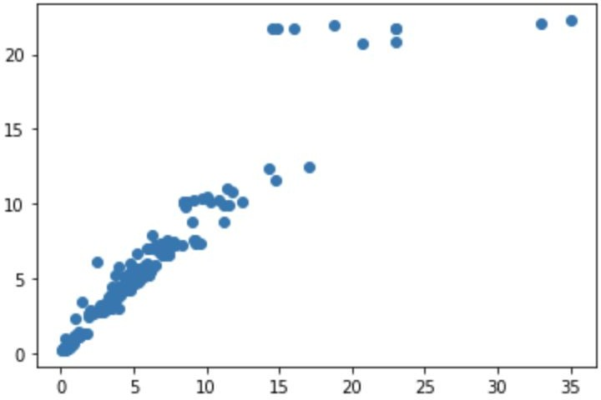
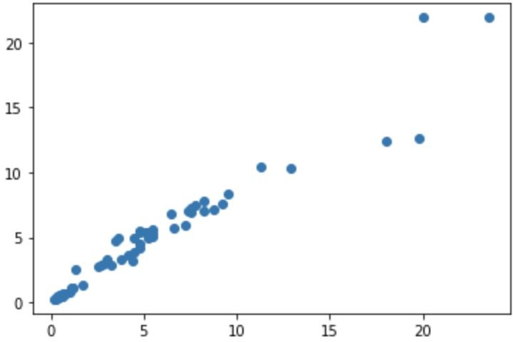
OBSERVATION
After the model is trained , we plotted the difference between test and train data along with the predictions made using displot . This is shown in normal distribution with mean 0.
This tells us that the error is not much. So the predicted value might actually be accurate.
Also when we use the scatter plot the test points and the predicted points are along the line y=x , which means that the predicted values are equal to the test values using the model.

Slide 19
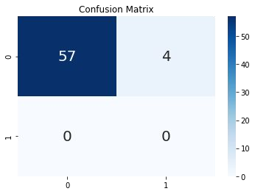
OBSERVATION
The performance measures are found using the Root Mean Square Error , R2 Score , Mean Square Error.
Also accuracy of the model is calculated from the sklearn’s built in functions. As this is only done for classiﬁcation we made our predicted output using a cutoff. If the difference between the test and predicted value is greater than cutoff (MSE) then we classify as wrongly predicted else correct prediction.
Accuracy of the model calculated from the “accuracy_score” gave us a score of 93.4 percentage.
Also calculating the Root Mean Square Error for the test and predicted test values is 1.36.
Calculating the Mean Square Error for the test and predicted test values we get 1.97.
accuracy of the model : 0.9344262295081968

Slide 20
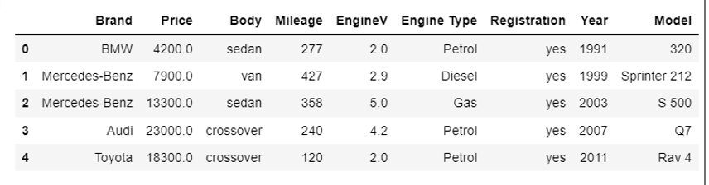
DATA SET-2
The data we have used in this project was downloaded from Kaggle.
It was uploaded from Cardekho.com .
The dataset consists of 4345 rows and 9 columns with no null values.
Column data consist of independent Features. The independent features contain both categorical and numeric values.

Slide 21
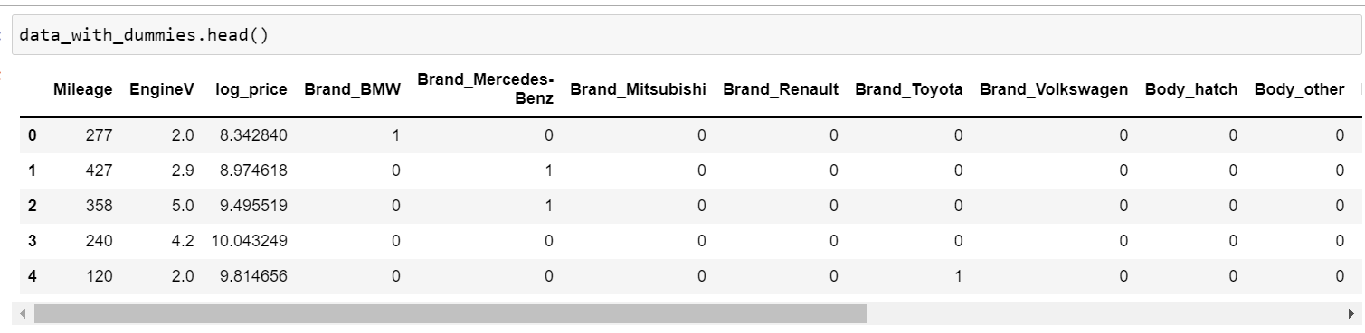
DATA SET MANIPULATION
From the original dataset we searched for null values using “isnull()”.
Removed the “Model” column from the dataset. We added a new feature “” lop_price”, “BRAND_bmw” it includes all car names seperated. It also effects our data.
As the dataset has numerical values and categorical values , We remove multiple columns of the dataset using the get_dummies function as some columns contain the same information because the original column could assume a binary value,

Slide 22
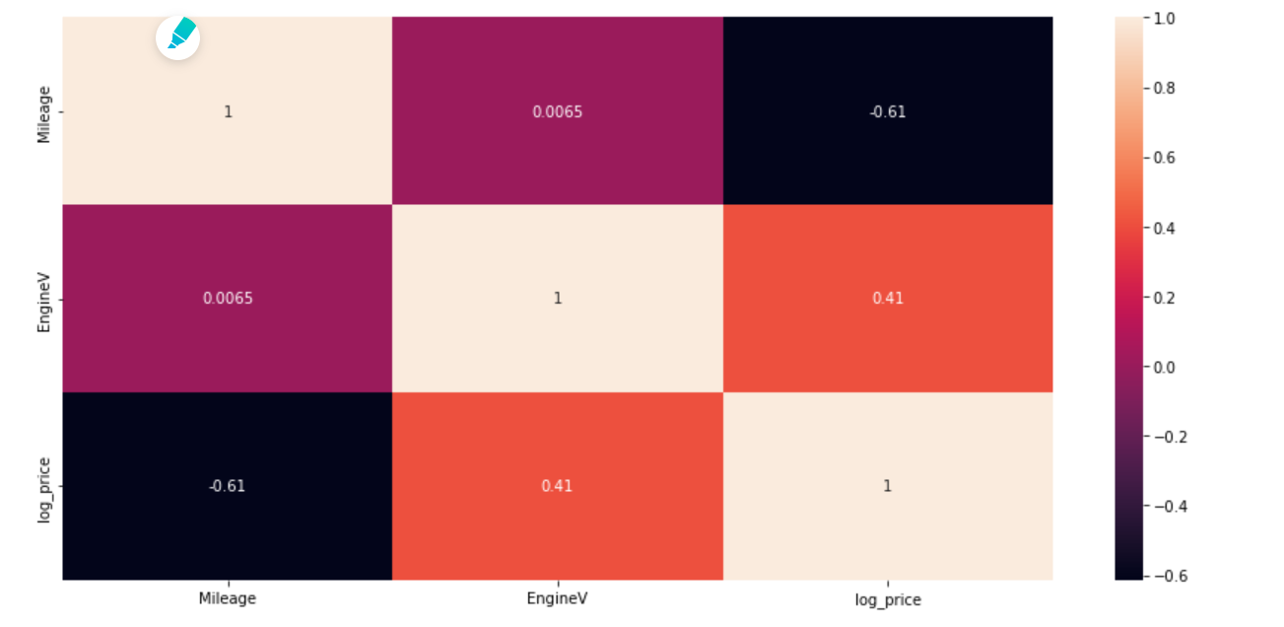
FINAL DATASET
Using the Extra Trees Regressor the feature importances are found.
The Present Price is the feature with most importance
And also we computed the correlation of all the features , we used “pearson” method.
And from that the we found that Selling price and the present price are much correlated.
And a heatmap is used to plot the correlation between 2 features.

Slide 23
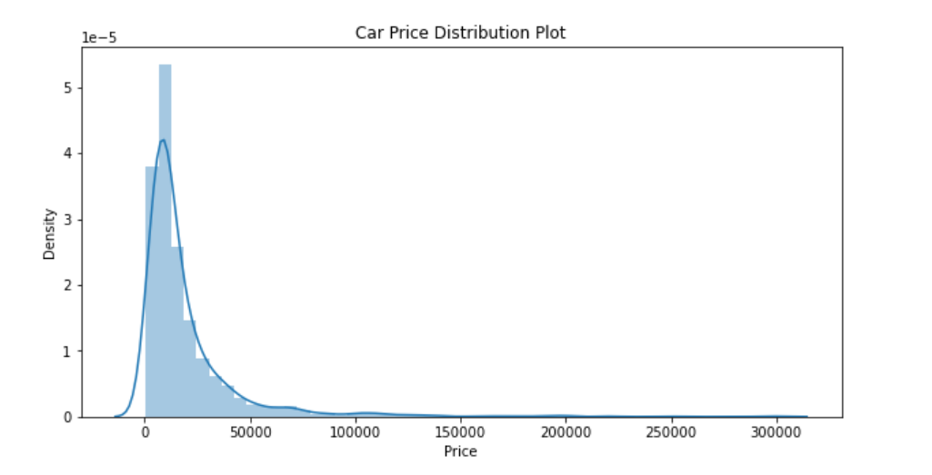
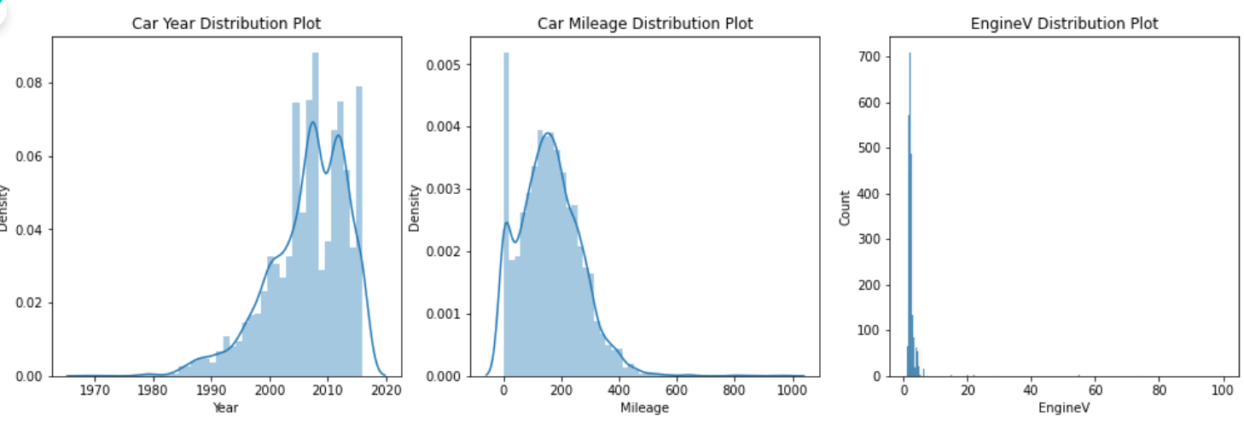
OBSERVATION
In data visualization we have ploted graph on prices and their density.
So the predicted value might actually be accurate.
Here it is clearly visible that there are some outliers in Price, year, Mileage and EngineV numerical veriables.

Slide 24
MODELS
As the problem dataset is based on regression we took
1. Linear Regression
2. Random Forest Regression
3. GBT
These algorithms we used in our dataset.

Slide 25
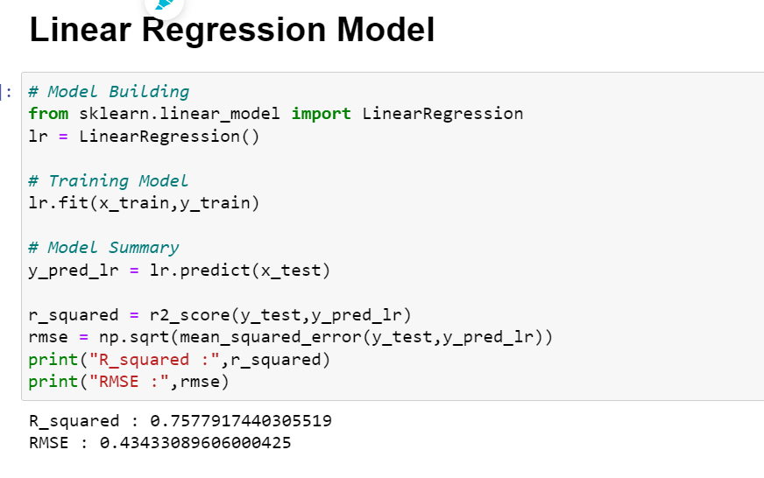
LINEAR REGRAESSION
HERE ACCURACY IS 0.75

Slide 26
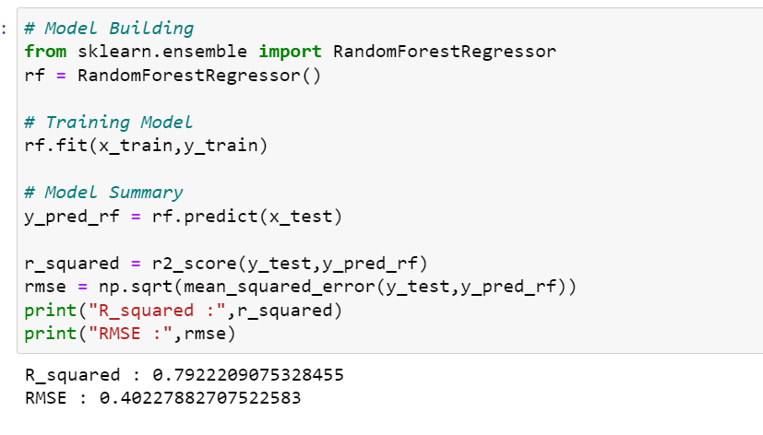
Random forest regression

Slide 27
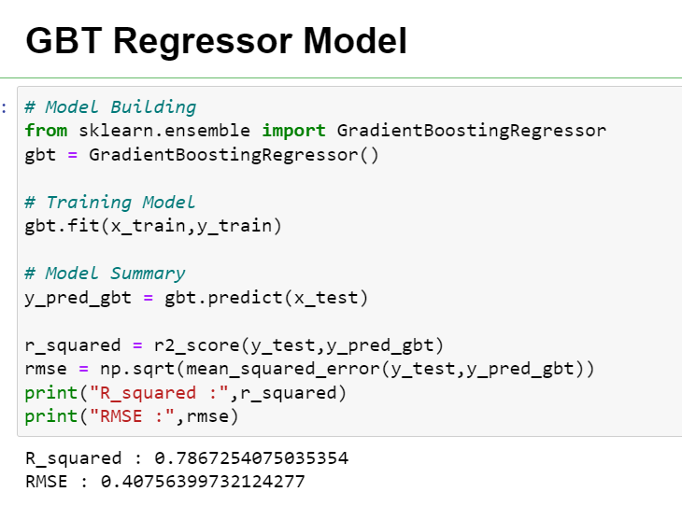
GBT

Slide 28
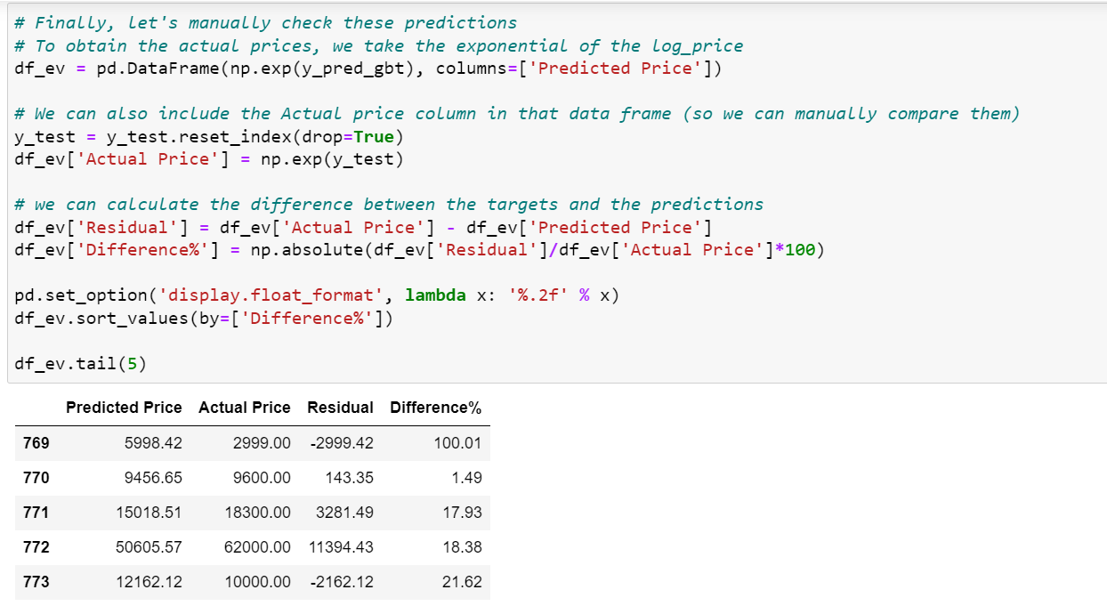
Test the model by giving input

Slide 29




THANK YOU!
“Predicting the future isn’t magic It’s Artiﬁcial Intelligence.”
~Dave Waters
CREDITS: This presentation template was created by Slidesgo, including icons by Flaticon, and infographics & images by Freepik and illustrations by Stories

